Slide 1
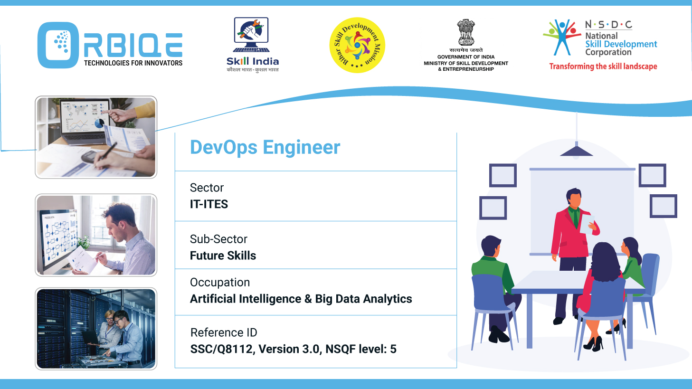
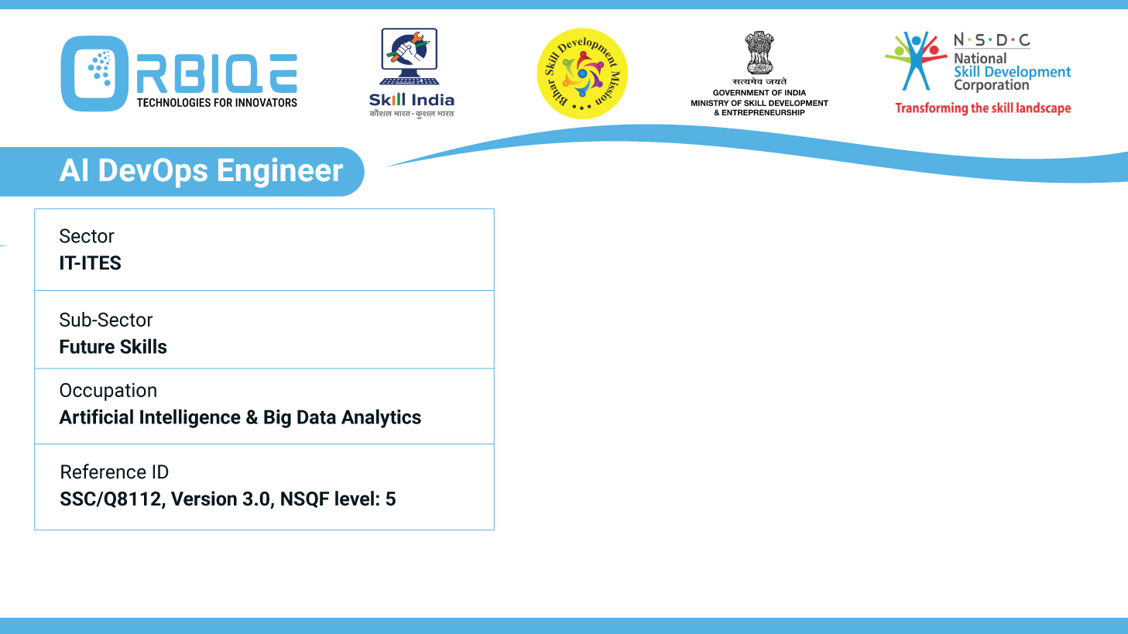
Name- Krishna Kant Dubey

Slide 2

Pre-Migration Precision: Validation and Migration Approaches

Slide 3
Agenda
Perform pre migration validation using database documentation and apply different approaches to migrate databases, ensuring accuracy and integrity in the migration process

Slide 4
Pre-migration validation with the right migration approaches
Pre-Migration Validation Using Database Documentation
Migration Approaches to Ensure Accuracy & Integrity
Final Validation Post-Migration

Slide 5
Pre-Migration Validation Using Database Documentation
Database Discovery & Documentation
Data Profiling & Quality Assessment
Validation Planning
Security & Compliance Checks

Slide 6
Database Discovery & Documentation
Catalog all database instances (production, staging, backups).
Document schema, stored procedures, triggers, indexes, and constraints.
Record user roles, access controls, and scheduled jobs

Slide 7
Data Profiling & Quality Assessment
Identify duplicates, nulls, orphaned records, and referential integrity issues.
Use profiling tools to assess completeness, consistency, and accuracy.
Cleanse and normalize data before migration

Slide 8
Validation Planning
Define success metrics (e.g., 99.999% accuracy).
Create test cases for schema and data validation.
Backup all source data for rollback safety

Slide 9
Security & Compliance Checks
Audit sensitive data and encryption protocols.
Ensure compliance with GDPR, HIPAA, or other regulations

Slide 10
Migration Approaches to Ensure Accuracy & Integrity
Big Bang Migration
Phased Migration
Parallel Migration
Replication-Based Migration
ETL-Based Migration

Slide 11
Big Bang Migration
Description: Entire database is migrated in one go.
Pros: Fast and simple.
Cons: High risk; requires downtime.
Best For: Small databases or non-critical systems.

Slide 12
Phased Migration
Description: Data is migrated in stages.
Pros: Easier rollback; less disruption.
Cons: Requires synchronization between old and new systems.
Best For: Large or complex databases

Slide 13
Parallel Migration
Description: Both systems run concurrently during migration.
Pros: Real-time comparison and validation.
Cons: Resource-intensive.
Best For: Mission-critical applications.

Slide 14
Replication-Based Migration
Description: Use tools like AWS DMS to replicate data in real time.
Pros: Minimal downtime; continuous validation.
Cons: Requires setup and monitoring.

Slide 15
ETL-Based Migration
Description: Extract, transform, and load data using tools like Talend or Apache NiFi.
Pros: Ideal for schema transformation and cleansing.
Cons: Slower; requires mapping logic

Slide 16
Thank You

